Slide 1

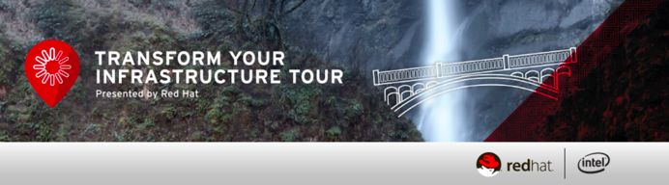
Deliver Microservices with RHEL Atomic & Docker
Ravi Srinivasan
Senior Consultant, Red Hat India

Slide 2
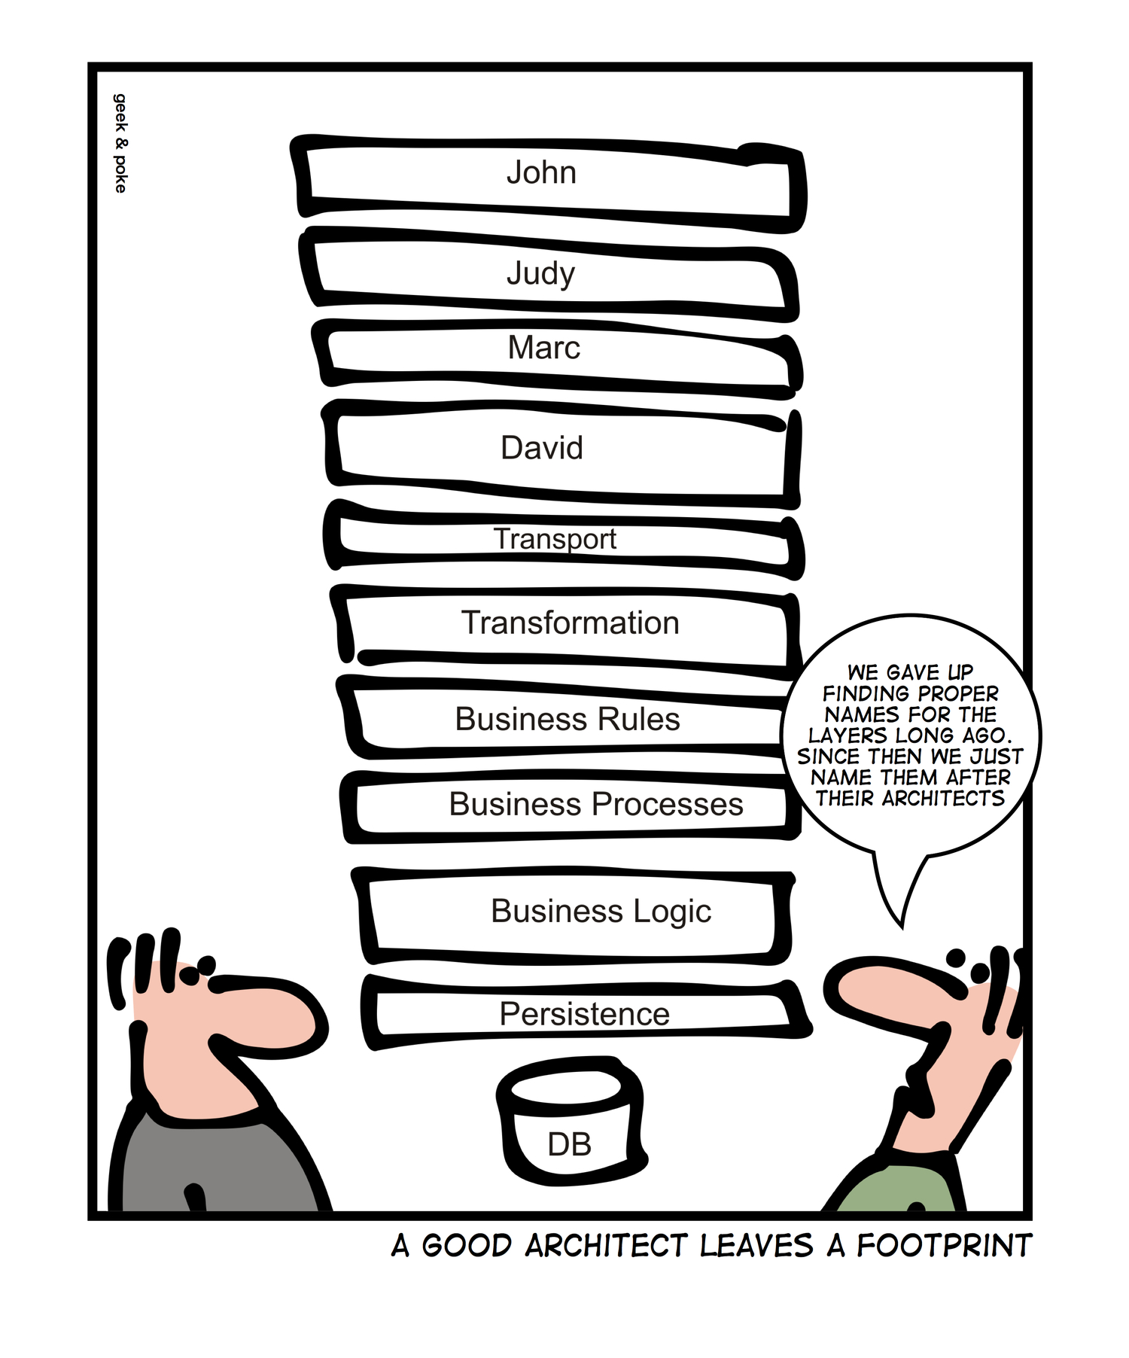
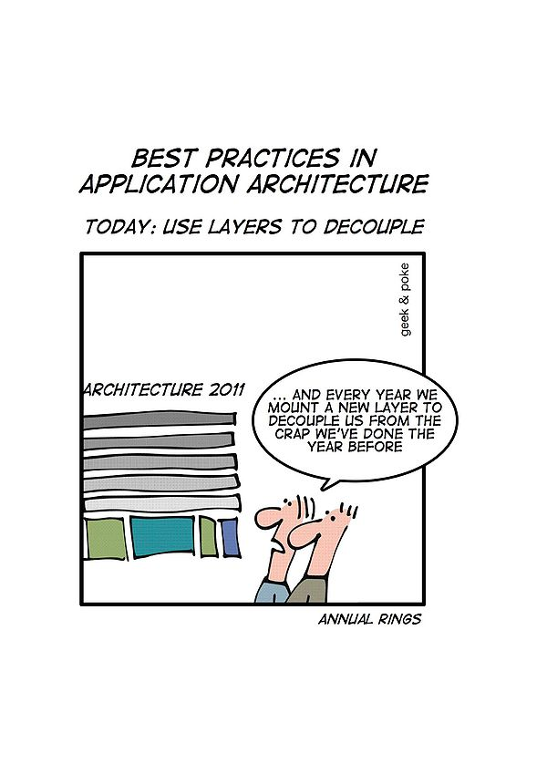

Slide 3
MONOLITH VS MICROSERVICES
“Don’t even consider microservices unless you have a system that's too complex to manage as a monolith”
- Martin Fowler
Source: http://martinfowler.com/bliki/MicroservicePremium.html

Slide 4
MICROSERVICES
“…an approach to developing a single application as a suite of small services, each running in its own process and communicating with lightweight mechanisms, often an HTTP resource API.”
- Martin Fowler
Source: http://martinfowler.com/bliki/MicroservicePremium.html

Slide 5
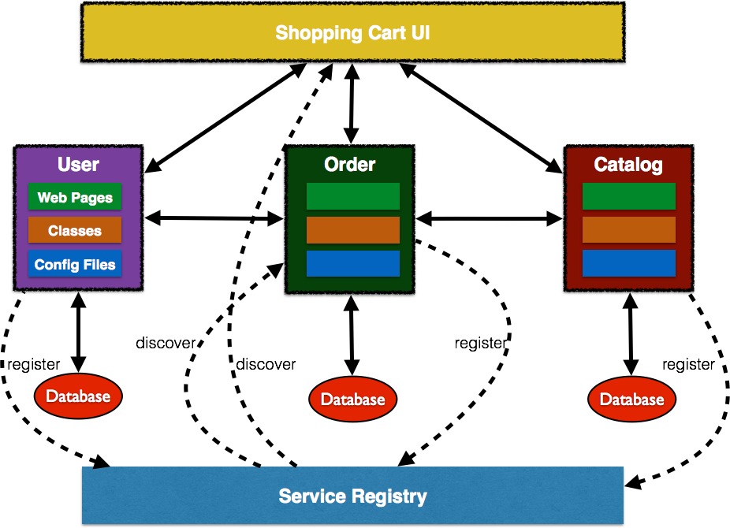
MICROSERVICES ADVANTAGES
Fast to develop, easier to maintain and understand
Starts faster, speeds up deployments
Local change can be easily deployed, great enabler of CD
Fault isolation
Services can be scaled independently
Local changes can be deployed easily
Eliminates any long-term commitment to a technology stack
Flexible choice of technology

Slide 6
USE CASES
STATELESS, SCALE OUT type workloads
  API Gateways
  Stateless Web Applications
Parallel processing – Map/Reduce Type workloads
Demand Based Scaling of workloads
DevOps CI/CD type workflows/Automated Testing
Case Study – E-Gov Services platform
  Seasonal demand challenges
  Massive user base (Scalability)
  Complex integration scenarios – many Ad-Hoc
  Must be Cloud ready
  Security

Slide 7
ERA OF “CONTAINERLESS” APPLICATION
Truly containerless
  NodeJS
  Vert.x
Container as a dependency (embedded)
Self-contained executable fat jar
(Opinionated) frameworks to help
  Dropwizard (Jetty)
  Spring Boot (Tomcat, Jetty or Undertow)
  WildFly Swarm (Wildfly)
Service
Biz Logic
Bean Validation
Logging
JSON
REST
Container
JVM

Slide 8
Red Hat's Microservices Vision

Slide 9
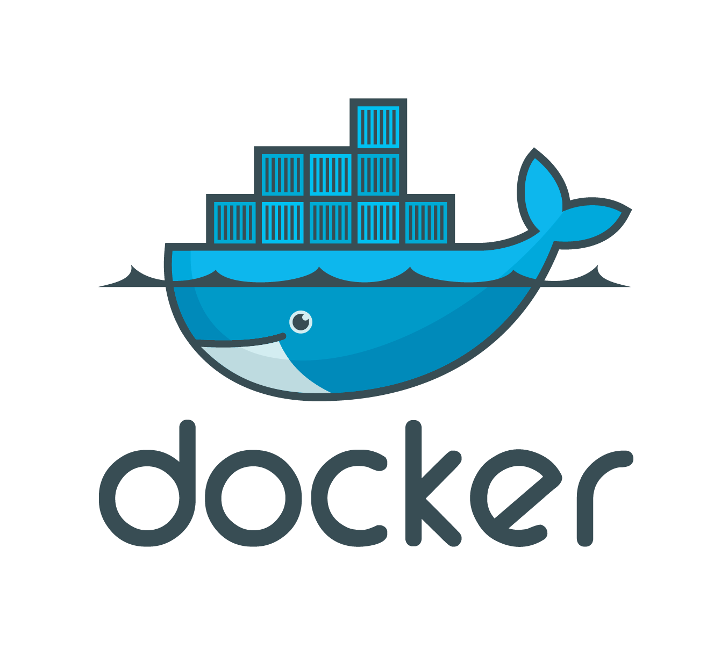
MICROSERVICE + OS CONTAINER
Micro
Service
OS CONTAINER

Slide 10
RHEL ATOMIC HOST:
THE WAY TO RUN DOCKER
Micro
Service
Micro
Service
Micro
Service
Micro
Service
Micro
Service
Micro
Service
Micro
Service
Micro
Service
Micro
Service
RHEL ATOMIC HOST
RHEL ATOMIC HOST
RHEL ATOMIC HOST

Slide 11
KUBERNETES FOR ORCHESTRATION
Micro
Service
Micro
Service
Micro
Service
Micro
Service
Micro
Service
Micro
Service
Micro
Service
Micro
Service
Micro
Service
OPENSHIFT ENTERPRISE
RHEL ATOMIC HOST
RHEL ATOMIC HOST
RHEL ATOMIC HOST
KUBERNETES

Slide 12
Containers are:
  software packaging concept that typically includes an application and all of its runtime dependencies
  easy to deploy
  portable across host systems
  means to isolate application
  from host OS
Virtualize the App, not the OS
CONTAINER
APP
LIBS
HOST OS
SERVER

Slide 13


Container Layering
New images can be created by adding layers
Layering model allows for specialization
Base image and select number of platform layers provided by Red Hat
ISV images form the base of the RHEL ecosystem
Stack optimized for individual application with minimal packaging per layer
ISV Layer
Platform
RHEL Base
Custom
ISV Layer
Platform
RHEL Base
Platform
RHEL Base
Custom
ISV Layer
JBoss
JBoss
SCLs
SCLs
RHEL Base
RHEL Base
RHEL
RHEL
Notes:
Linux containers provide the capability to package an application with it’s dependencies using the docker format. The starting layer is the Red Hat provided Red Hat Enterprise Linux platform image layer. If a customer has an application certified on RHEL 6, they would choose the latest Red Hat Enterprise Linux 6 platform image (6.6) and containerize the application. This allows the customer to move the application from a Red Hat Enterprise Linux 6 host to a Red Hat Enterprise Linux 7 host. If a customer desires to build and run their application on a Red Hat Enterprise Linux 7 host, the Red Hat Enterprise Linux 7 platform image can be used to containerize the application. Thus an application that is certified on Red Hat Enterprise Linux 7 host can be moved into a container.
Additional layers can be applied in the dockerfile: this could be additional packages from an entitled Red Hat Enterprise Linux system, or an ISV layer can be applied.

Slide 14
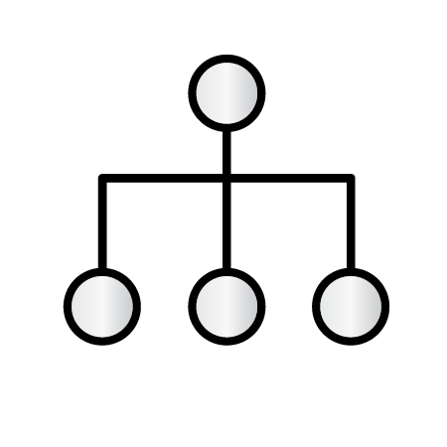


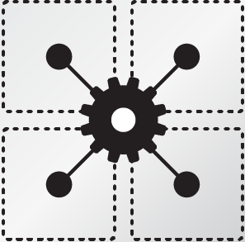
RHEL Atomic
ISOLATION WITH
LINUX CONTAINERS
Isolating applications on host operating system
Security
Portability across host systems
CONTAINER FORMAT WITH DOCKER
Interface for communications, configuration, data persistence, provisioning
Content agnostic
Infrastructure
agnostic
ORCHESTRATION WITH
KUBERNETES
Orchestrate at scale
Define app topologies
Handle networking
Manage state
Schedule across hosts
RPM OSTREE FOR ATOMIC TREES
New deployment model for RHEL, uses RHEL RPMs under the covers
Single shot updates and rollbacks
Applications run inside containers
Notes:
Shipping containers can be interchanged by shipping, rail, and truck companies easily across borders without having to make any adjustments because their dimensions comply to international standards. To make containerized applications portable, similar standards must be established, and Red Hat is actively working with the open source community through Project Atomic to help drive standards for Linux containers in the industry.
Container Host - Ability to isolate and secure applications on the host operating system
Container Image - Signed/encrypted image that includes what's needed to run an app container
Orchestration - Managing a cluster of Linux containers as a single system
Registry/Discovery - Finding and consuming trusted application container image via federated sources

Slide 15



RHEL Atomic Host
IT IS RED HAT ENTERPRISE LINUX
OPTIMIZED FOR CONTAINERS
MINIMIZED
FOOTPRINT
SIMPLIFIED
MAINTENANCE
ORCHESTRATION
AT SCALE
Inherits the complete hardware ecosystem, military-grade security, stability and reliability for which Red Hat Enterprise Linux is known.
Minimized host environment tuned for running Linux containers while maintaining compatibility with Red Hat Enterprise Linux.
Atomic updating and rollback means it’s easy to deploy, update, and rollback using imaged-based technology.
Build composite applications by orchestrating multiple containers as microservices on a single host instance.
Notes:
With Red Hat Enterprise Linux Atomic Host, users can build and run Docker-formatted containers and rapidly provision applications on those containers.
It inherits the complete hardware ecosystem, military-grade security, stability and reliability for which Red Hat Enterprise Linux is known. So any containers designed to run on Red Hat Enterprise Linux Atomic Host will also work on Red Hat Enterprise Linux 7.
Red Hat Enterprise Linux Atomic Host is a secure, minimized footprint operating system that is optimized to run Linux Containers.
A new update mechanism based on rpm-ostree makes incremental updating of the host OS much simpler. It also automatically keeps the previous version of the host OS, supporting the ability to easily rollback to an earlier state.
Container orchestration simplifies the building of scalable, reliable container- based applications and systems.

Slide 16


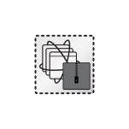
CONTAINER ORCHESTRATION, SCHEDULING, AND MANAGEMENT VIA KUBERNETES
Critical for building containerized application infrastructure
Orchestrate application services that span multiple containers across multiple Linux hosts
Schedule containers across multiple hosts in desired topology
  Enable manual and automated scaling up & down
Manage container lifecycle with declarative model for health management to detect and restart on failure
ORCHESTRATION
VIA KUBERNETES

Slide 17







Atomic Host Deployment
PHYSICAL SYSTEM ISO
Anaconda installation
Kickstart installation
PXEboot installation
CERTIFIED HYPERVISORS
RHEL (Qcow2 for KVM based HV)
RHEV (OVA import for KVM based HV)
VMware (OVA for ESX based HV)
Microsoft (VHD for Hyper-V HV)
PRIVATE CLOUDS
RHEL Open StackPlatform (Qcow2 for KVM based HV)
PUBLIC CLOUDS
RHEL Atomic Host images available on select public clouds via cloud access
Amazon Web Services (AWS)
Google Compute Engine (GCE)
Notes:
Shipping containers can be interchanged by shipping, rail, and truck companies easily across borders without having to make any adjustments because their dimensions comply to international standards. To make containerized applications portable, similar standards must be established, and Red Hat is actively working with the open source community through Project Atomic to help drive standards for Linux containers in the industry.
Container Host - Ability to isolate and secure applications on the host operating system
Container Image - Signed/encrypted image that includes what's needed to run an app container
Orchestration - Managing a cluster of Linux containers as a single system
Registry/Discovery - Finding and consuming trusted application container image via federated sources

Slide 18




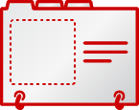

SIMPLIFYING CONTAINER ADOPTION
RED HAT CONNECT
for technology
partners
RED HAT CONTAINER
DEVELOPMENT
KIT (CDK)
RED HAT
CONTAINER
CERTIFICATION
RED HAT
CONTAINER
REGISTRY
LEARN
BUILD
CERTIFY
DISTRIBUTE
https://connect.redhat.com

Slide 19
Demo 1: Distributed CDR Processing
Demo 2: Polyglot Microservices applications

Slide 20
Thank You
rsriniva@redhat.com
github.com/rsriniva/itwb-demo

